Slide 1


Résumé & Cover Letter
Session V: Career Exploration

Slide 2
LEARNING OBJECTIVES
Define the purpose and contents of a résumé
Identify characteristics of an effective résumé
Identify characteristics of an effective cover letter
Write student résume and cover letter

Slide 3

Chapter outline
1. Résumé
2. Cover letter
This Photo by Unknown author is licensed under CC BY-SA-NC.

Slide 4

The most important tool you have on a résumé is language.
Jay Samit, digital media innovator

Slide 5
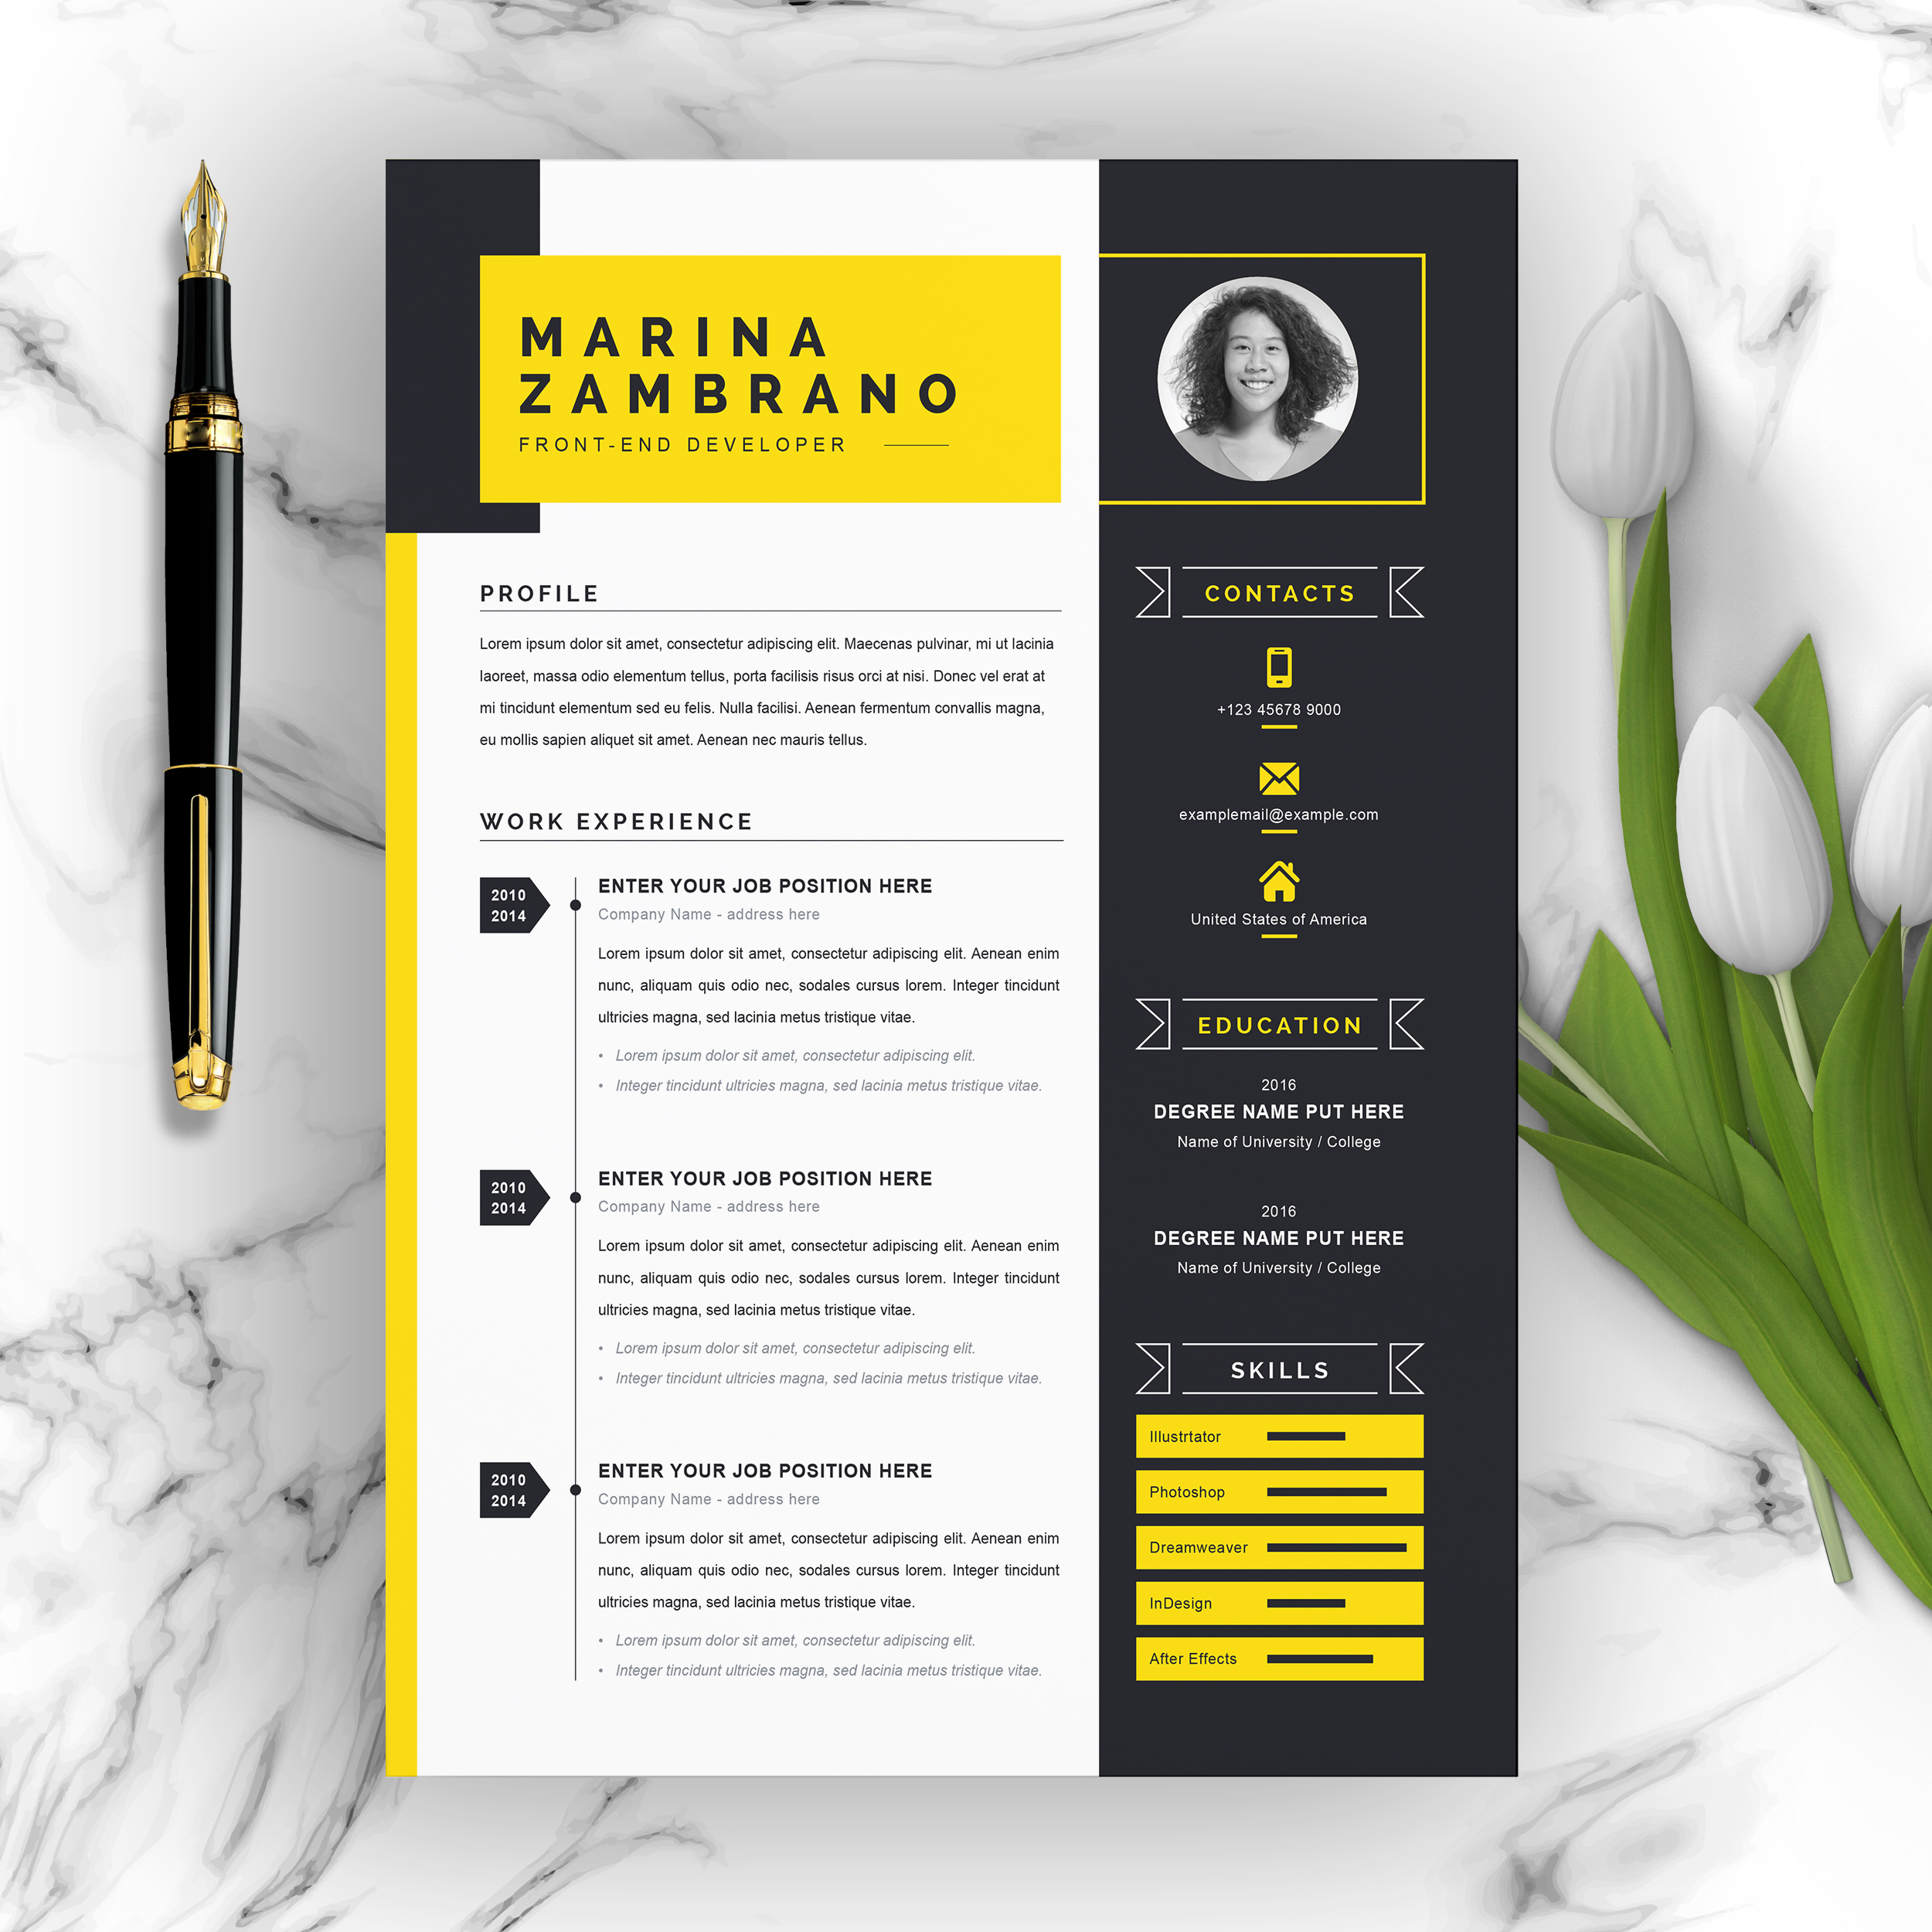
1. Résumé
The most important tool you have on a résumé is language.
Jay Samit, digital media innovator

Slide 6
What is a résumé
A résumé is a “selfie” for business purposes.
It is a written picture of who you are—it’s a marketing tool, a selling tool, and a promotion of you as an ideal candidate for any job you may be interested in.
The word résumé comes from the French word résumé, which means “a summary.”

Slide 7
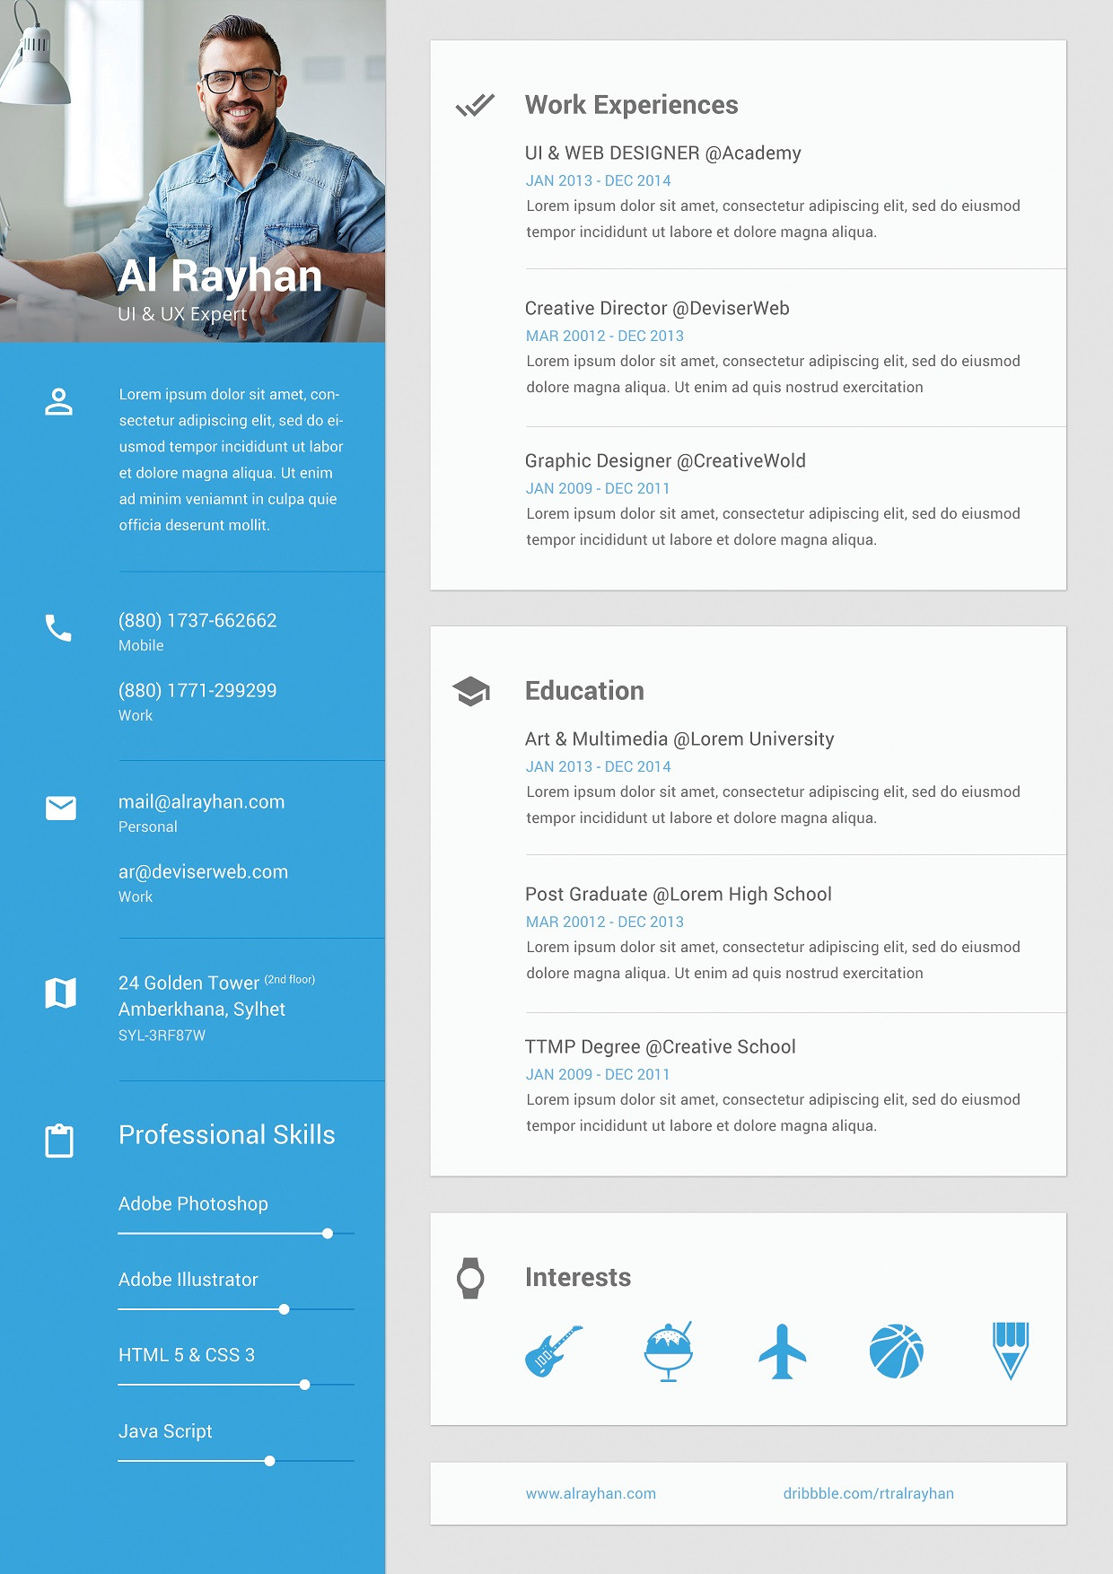
Your Résumé: Purpose and Contents
Education
Work experience
Job-related skills
Accomplishments
Volunteer history
Internships
Residencies, and/or more.

Slide 8
Elements of Your Successful Résumé
Reverse chronological résumé
Functional résumé
Hybrid résumé
Video, infographic, and Web-site résumé

Slide 9
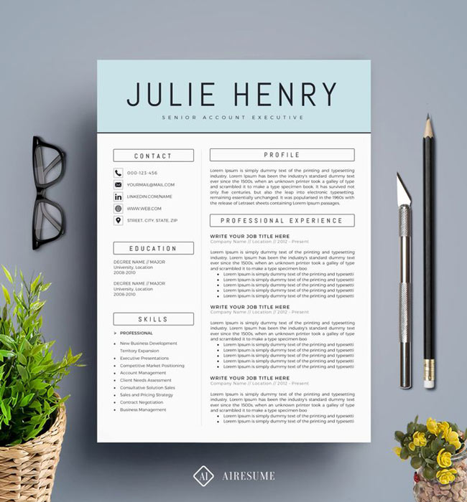
Elements of Your Successful Résumé
Opening
Education
Heading
Career objective
Summary of qualifications
Most recent information first
Name and location of each school
Dates of attendance
Degrees
Major
Achievements

Slide 10
Elements of Your Successful Résumé
Experience
Activities/Honors/
Special Skills
References
Dates of employment
Job title
Employer
Employer’s location
Job responsibilities stated using action words and keywords
Special skills
Computer competence
Community service
Published works
Public presentations
Military service
Organization memberships
Special interests
Characteristics
Positive
Related to prospective job and its requirements
Complete and easy-to-use contact information on a separate sheet of paper
Who
Previous employers
Instructors (college or high school)

Slide 11

Avoid
Typos –spelling mistake
Discrimination religion, politics, gender, marital status, color, race
Too much for the eyes
Sensitive/non job-related photos
Abbreviations.

Slide 12
Refining Your Résumé
Print on light-colored paper with a laser printer.
Arrange information simply but attractively.
Use action verbs and strong phrases.
Show a clear match between qualifications and job requirements.
Ask for a peer review.
Proofread carefully.
Use a Summary of Qualifications to highlight accomplishments.

Slide 13
Résumé Contents and Structure
Your contact information: name, address, phone number, professional email address
A summary of your skills: 5–10 skills you have gained in your field; you can list hard skills as well as soft skills (refer to the Professional Skill Building topic in this course)
Work experience: depending on the résumé format you choose, you may list your most recent job first; include the title of the position, employer’s name, location, employment dates (beginning, ending)
Volunteer experience
Education and training: formal and informal experiences matter; include academic degrees, professional development, certificates, internships, etc.
References statement (optional): “References available upon request” is a standard phrase used on résumés, although it is often implied
Other sections: may include a job objective, a brief profile, a branding statement, a summary statement, additional accomplishments, and any other related experiences

Slide 14
Top Ten Tips for a Successful Résumé
Aim to make a résumé that’s 1–2 pages long on letter-size paper.
Make it visually appealing.
Use action verbs and phrases. See Action Words and Phrases for Résumé Development.
Proofread carefully to eliminate any spelling, grammar, punctuation, and typographical errors.
Include highlights of your qualifications or skills to attract an employer’s attention.
Craft your letter as a pitch to people in the profession you plan to work in.
Stand out as different, courageous.
Be positive and reflect only the truth.
Be excited and optimistic about your job prospects!
Keep refining and reworking your résumé; it’s an ongoing project.

Slide 15
Caution
Do not mention your age, gender, height or weight.
Do not include your social security number.
Do not mention religious beliefs or political affiliations, unless they are relevant to the position.
Do not include a photograph of yourself or a physical description.
Do not mention health issues.
Do not use first-person references. (I, me).
Do not include wage/salary expectations.
Do not use abbreviations.
Proofread carefully—absolutely no spelling mistakes are acceptable.

Slide 16
Your Résumé: It’s Like Online Dating
ACTIVITY: CREATE YOUR RÉSUMÉ
Objectives:
Compile data reflecting your professional and educational skills and accomplishments.
Assess the main résumé formats and select one that meets your needs.
Create a first draft of your professional résumé.
Directions:
Compile all needed information for your résumé, including your contact information, a summary of your skills, your work experience and volunteer experience, education and training (including your intended degree, professional development activities, certificates, internships, etc.). Optionally you may wish to include job objective, a brief profile, a branding statement, additional accomplishments, and any other related experiences.
Select one of the résumé builder tools listed above in the Résumé Writing Resources table.
Create your résumé, following instructions at your selected site.
Save your document as a PDF file.
Follow instructions from your instructor on how to submit your work.

Slide 17
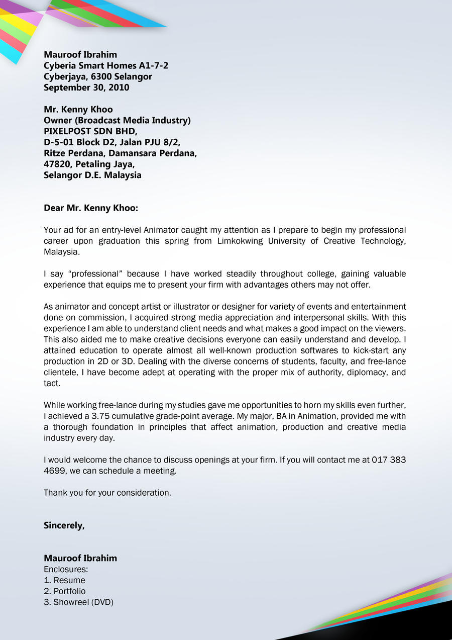
2. Cover Letter

Slide 18
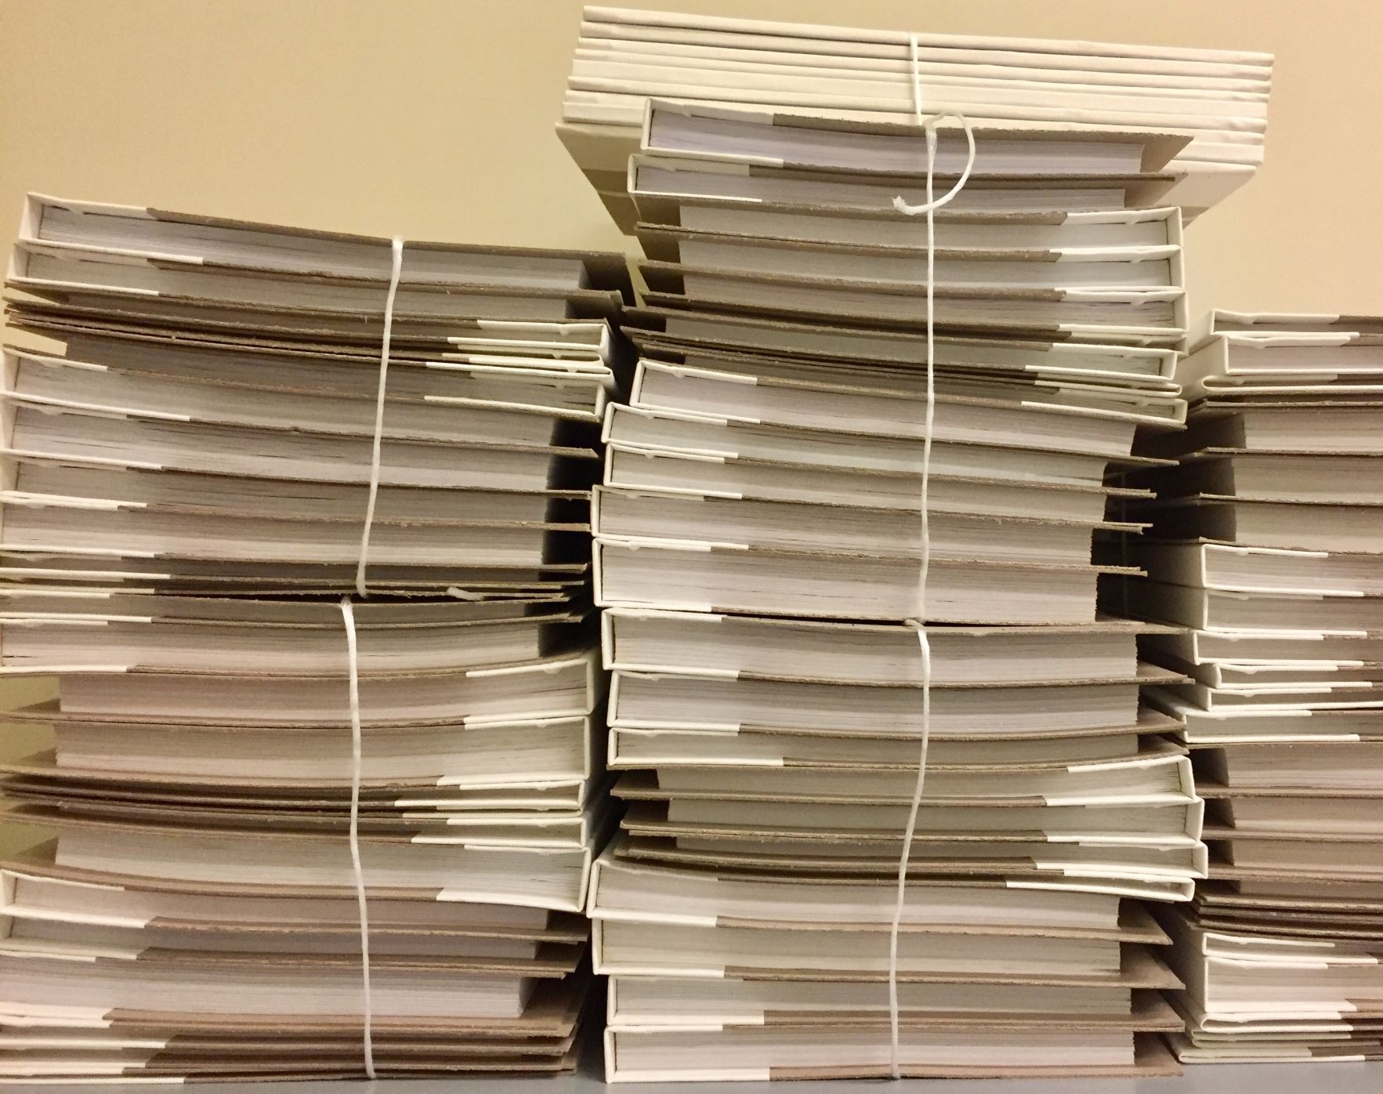
Cover letters matter. When you have to go through a pile of them, they are probably more important than the résumé itself.
woodleywonderworks

Slide 19

A cover letter is...
Cover letter is to introduce yourself to an employer and explaining why you are suited for a position.
A marketing tool that highlights your most attractive qualifications as a potential employee

Slide 20

Characteristics of an Effective Cover Letter
Get the attention of the prospective employer
Set you apart from any possible competition
Identify the position you are interested in
Specify how you learned about the position or company
Present highlights of your skills and accomplishments

Slide 21
Characteristics of an Effective Cover Letter (Cont.)
Reflect your genuine interest
Please the eye and ear
Complete information for comparison to skills required for the position
Integrity (accuracy) of the information
Legibility of the application

Slide 22
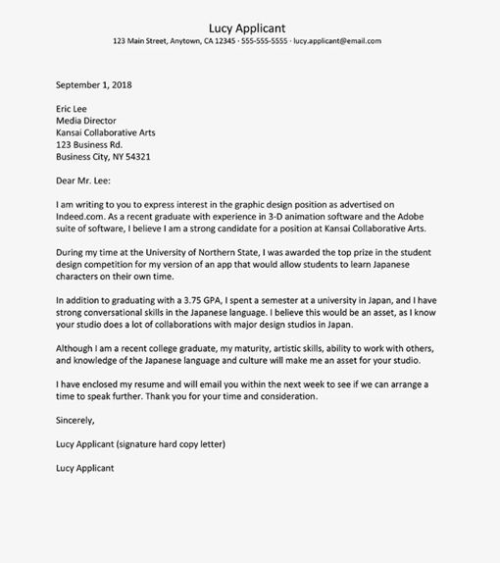

Example of student cover letter

Slide 23
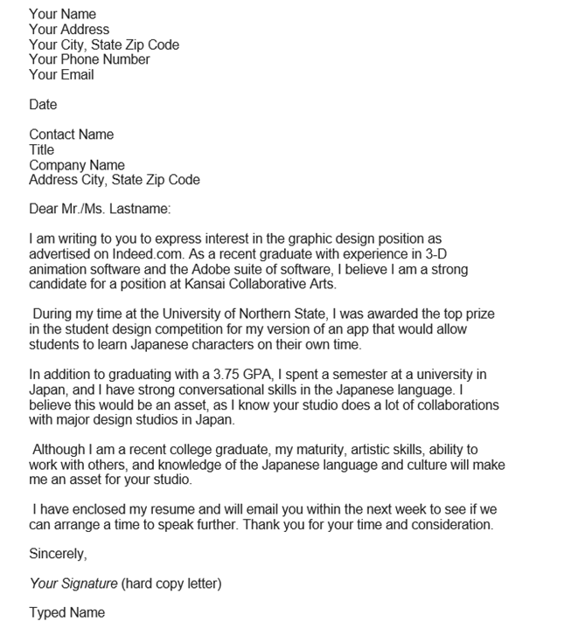
College Graduate Cover Letter Example

Slide 24
LinkedIn Cover Letter
This site contains articles, experts, jobs, and more: get all the professional insights you need on LinkedIn: https://www.linkedin.com/

Slide 25
An Application Letter Achieves:
Attention
Interest
Desire
Action

Slide 26
An Application Letter Achieves:
Attention
Gain favorable attention.
Express interest in the position.
Motivate the receiver to read the entire application letter.
Interest
Market your qualifications
Identify special strengths and attributes and relate how they meet job requirements.

Slide 27
An Application Letter Achieves:
Desire
Describe selected accomplishments that show how you can benefit the company.
Motivate the receiver to look closely at your résumé.
Action
Request an interview or propose a future meeting.
Provide easy-to-use contact information.
Suggest scheduling alternatives.

Slide 28
Anatomy of a Cover Letter
A basic formula for cover letters is as follows:
Standard business letter address format—prospect name, title, company, address—top left
Salutation (yes, it should be to a real person—take time to know your target)
First paragraph—why you are writing? To meet that company's specific need(s)!
Second paragraph—briefly state two or three top skills (from the Summary section of your resume), then immediately follow with the benefits these features (and you as a person) will provide to the company.
Third paragraph—close! Not just the ending of the letter, but the "sales closer" to the letter. Close the sale. Give your target contact a specific action to take and a backup action you will take if you do not get a response.

Slide 29
Anatomy of a Cover Letter
A basic formula for cover letters is as follows:
Standard business letter address format—prospect name, title, company, address—top left
Salutation (yes, it should be to a real person—take time to know your target)
First paragraph—why you are writing? To meet that company's specific need(s)!
Second paragraph—briefly state two or three top skills (from the Summary section of your resume), then immediately follow with the benefits these features (and you as a person) will provide to the company.
Third paragraph—close! Not just the ending of the letter, but the "sales closer" to the letter. Close the sale. Give your target contact a specific action to take and a backup action you will take if you do not get a response.

Slide 30

Activity
Write a cover letter, think about where you want to work, the job you really enjoy and are capable of.
Draft and finalize your cover letter and share it with your classmates.

Slide 31


